Slide 1



SASEhack 2017
Data Science Track - Background and Overview
Collaboration space, Alexandria, VA
October 13-14, 2017

Slide 2
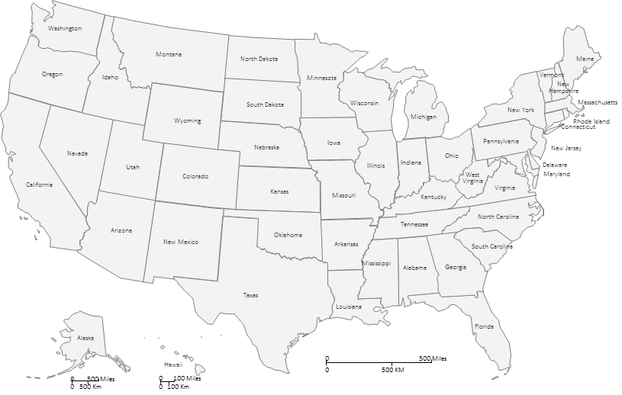
Background - Public Health vs Medicine
PUBLIC HEALTH | MEDICINE
Focused on populations and communities | Centered around the individual
Focused on disease prevention and wellness | Focused on disease diagnosis and treatment
Informed by community-level: Socioeconomic status Education quality Access to healthcare Access to food | Informed by the individual’s: Health behavior Genetics Conditions, diagnosis, medications Family history
Interventions include campaigns and policies intended to reduce smoking | Interventions are medical treatment of patient that has cancer

Slide 3
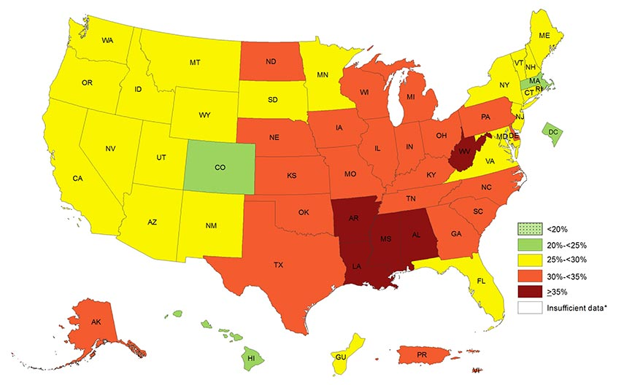
Why does Public Health Matter?
Health happens primarily outside of the healthcare system
In 2014, 34.0% of adults aged 18–64 had not seen or talked to a general doctor in the past 12 months
Several factors influencing health are outside of the control of any one individual (patient or doctor).
For example:
Today, more than one-third (36.5%) of U.S. adults have obesity (above 70% for overweight)
Adults consumed, on average, 11.3% of their total daily calories from fast food
While food and nutrition are important factors in obesity, up to 23.5 million people live more than one mile from a supermarket. Nearly half of them are also low-income
Rates of Obesity by State
Source: CDC
The above map shows significant variation in obesity by state. Understanding the structural reasons behind obesity can help leaders target the right interventions to the right population.
Notes:
Sources:
Caloric Intake: https://www.cdc.gov/nchs/products/databriefs/db114.htm
Obesity: https://www.cdc.gov/obesity/data/prevalence-maps.html
Food: https://www.tolerance.org/sites/default/files/general/desert%20stats.pdf
Healthcare Utilization: https://www.cdc.gov/nchs/data/databriefs/db245.pdf
Military Readiness: http://time.com/2938158/youth-fail-to-qualify-military-service/
Troops obesity: https://www.militarytimes.com/news/your-military/2016/09/11/the-u-s-military-has-a-huge-problem-with-obesity-and-it-s-only-getting-worse/

Slide 4
Why does Public Health Matter to the US Army?
The US Military must build and maintain health, readiness, and optimal performance for all US Armed Forces
US Army is making significant investments to holistically promote health and wellness for Service Members – mind, body, spirit, environment and relationships
However, public health challenges similarly impact the military population
A recent study found about 7.8 percent of the military is clinically overweight
Approximately 71% of the 34 million 17-to-24-year-olds in the U.S. would not qualify for military service because of reasons related to health, physical appearance and educational background, according to the Pentagon
In order to develop the best interventions, more insights are needed to holistically look at factors influencing health and wellness
Is there sufficient access to quality health care, facilities for physical fitness and nutritious food?
Are there community norms rooted in socioeconomic (or other) factors that influence individual behavior?
Are there structural factors at the local level that lead to higher prevalence of certain chronic conditions (e.g. mental health, diabetes, etc.)?
Notes:
Sources:
Military Readiness: http://time.com/2938158/youth-fail-to-qualify-military-service/
Troops obesity: https://www.militarytimes.com/news/your-military/2016/09/11/the-u-s-military-has-a-huge-problem-with-obesity-and-it-s-only-getting-worse/

Slide 5

The Challenge - How can Open data and data science help generate better insights?
Help us make sense of all the open data available to improve public health interventions both for the general population and for service members

Slide 6
If you need Somewhere to start …
Don’t let this slide limit your thinking!
Focus areas:
Look at aspects of the US Army Performance Triad (i.e. sleep, nutrition, activity) and prioritize areas for potential interventions
Development solutions:
Design or develop a dashboard or multiple dashboards to compile and summarize insights across disparate data sources
Find other data sources that are relevant for generating insights for public health decision making
Design or develop a model that can help identify and predict greatest opportunities for improvement

Slide 7
SASEhack 2017
Virtual Reality Track - Background and Overview
Collaboration space, Alexandria, VA
October 13-14, 2017

Slide 8



Spars team challenge
Background
The operational environment within which the soldier and squad operate is complex and dynamic due to varied threats and the increasing need for information to maintain situational awareness. Compounding the complexity of the environment is the increasing equipment load, which adds to the soldier’s physical stress. As load increases, there is concern that the weight and resulting physical burden may impact the soldier’s cognitive ability to completely understand events, maintain situational awareness, and assess risk which impact mission performance. Studies have documented that physical load have a correlation to cognitive abilities, however quantifying this correlation remains a challenge and military leaders need advanced data solutions and technologies to enable decisions that will positively affect soldier readiness.
Objective is to Help Shed Insight into Soldier Performance
How do we define cognitive ability?
How do we measure cognitive ability and physical stress?
How do we analyze the relationship between cognitive ability and physical stress?
Challenge Overview | Data Platform | Experiment Design | VR Simulation | Next Steps

Slide 9
VR Environment

Slide 10
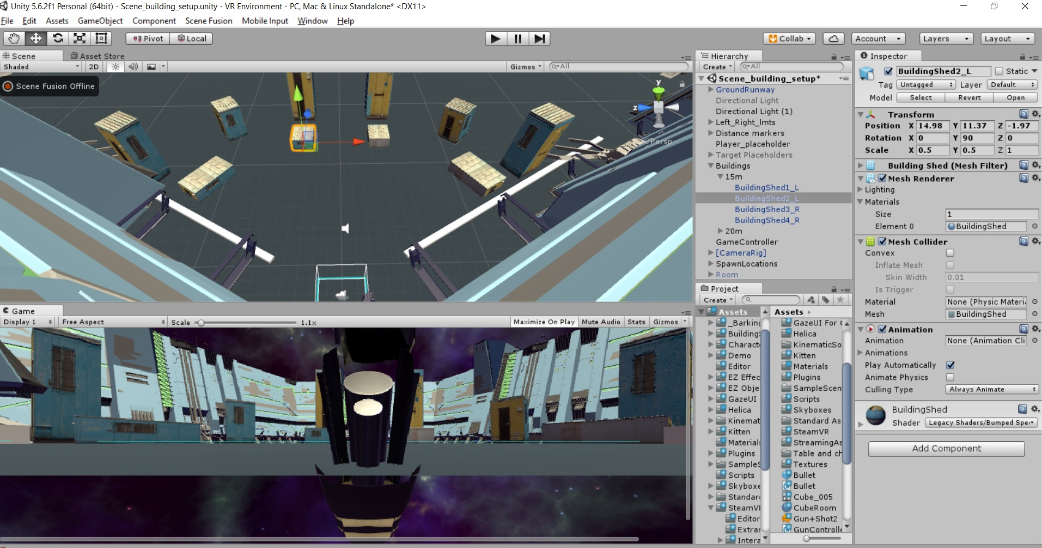
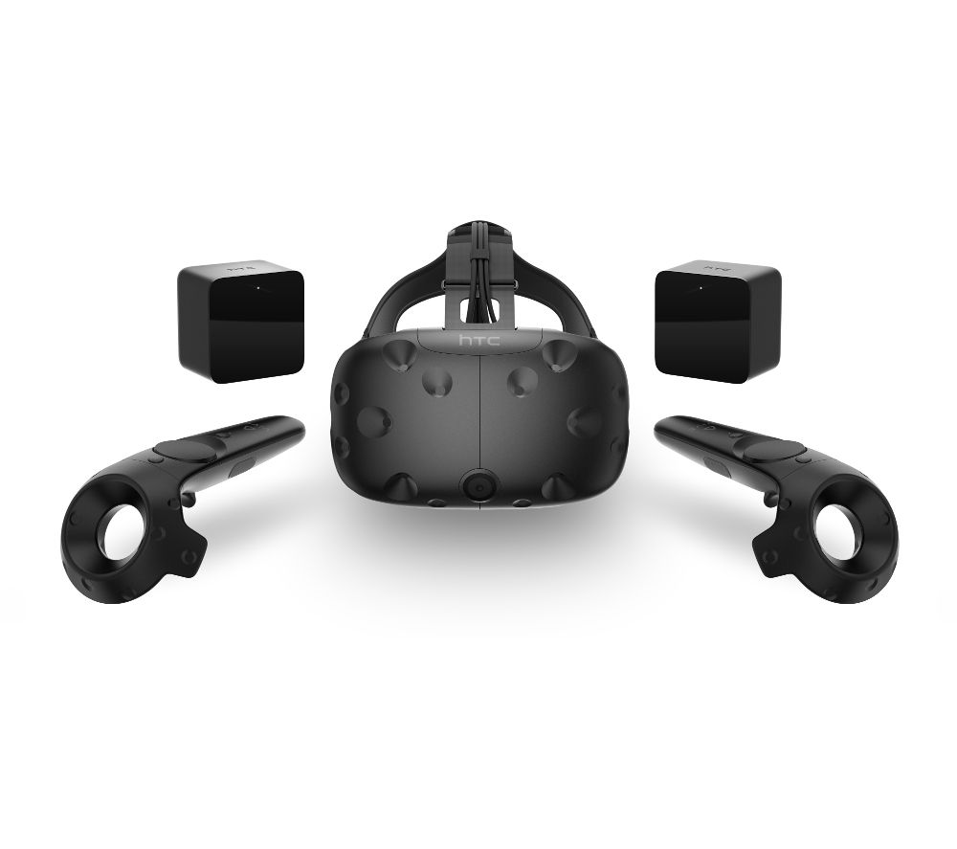
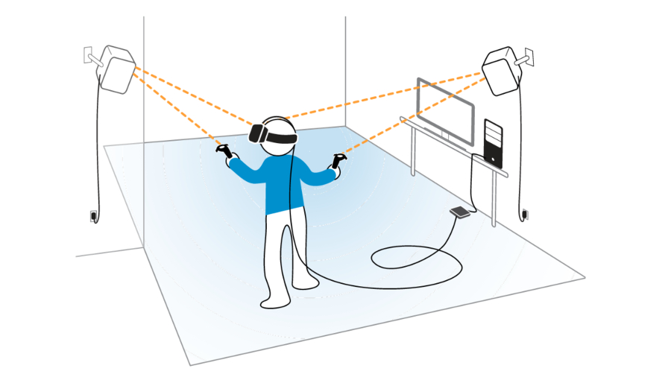
INTRO TO Virtual Reality AND UNITY
Explaining current virtual reality technology
Unity
Creation engine for video games
Programmed in C# language
Used to create the VR environment and the different shooting scenarios
Scripts export data from in-game observations to the data platform
HTC Vive
Wireless controllers combined with room-scale allows users to interact with virtual objects, environments, and characters
Used to precisely track movements within the VR environment

Slide 11
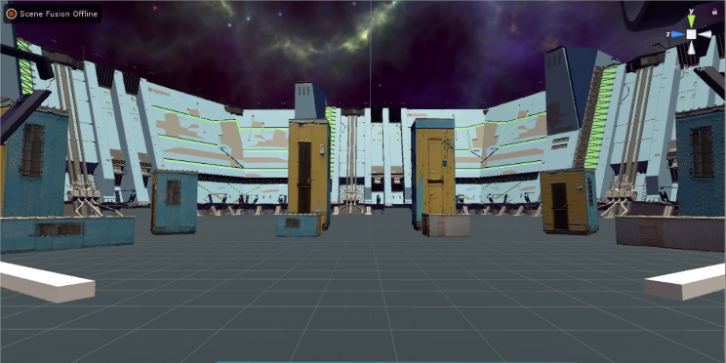
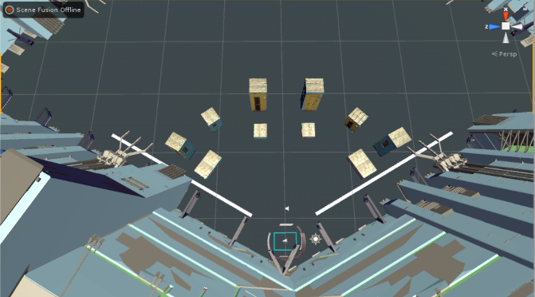
Unity VR environment
An inside look at the vr test scenarios
Fixed Shooter Position
Environment is set up as a shooting range
All targets are visible from the shooter’s position and are not obscured by obstacles
Shooter is not moving through environment
Virtual Shooting Environment
Minimalist buildings and walls minimize the amount of visual stimuli occurring on screen
Targets should be distinguishable from the environment
Participant stands in an open space with clear sightlines to all targets, but cannot move beyond a pre-determined area
Buildings of differing heights create a more dynamic shooting environment and requires the participant to scan for targets laterally and vertically.

Slide 12
test Scenario Example
How would you design your test scenarios? Walk through example below
Single Target
Multiple Targets
Scenario 1 | Scenario 3
Visual: stationary target (hostile or friendly) appears in front of participant Measure: accuracy, RT_{eng}** | Visual: multiple targets simultaneously appear in horizontal array within field of view Measure: accuracy, RT_{acq}*, RT_{eng}
Scenario 2 | Scenario 4
Visual: single target appears in random locations; participant must scan to identify target Measure: accuracy, RT_{acq}, RT_{eng} | Visual: multiple targets simultaneously appear in random locations within field of view; must scan to identify target Measure: accuracy, RT_{acq}, RT_{eng}
Fixed
Location
Multiple Location
*RTacq=time to acquire target with gaze; **RTeng=time to engage by shooting

Slide 13
Experiment design metrics

Slide 14
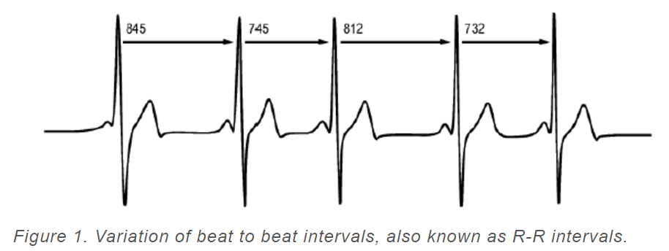
experiment design metrics and measures
Design | Develop | Analyze
Looking to industry and academia to define measures of cognitive and physical stress
Cognitive Measures and Metrics
Reaction time and target identification have been widely used as cognitive metrics for situational awareness
Sports psychology¹
Higher performing athletes are able to block out unnecessary visual stimuli and focus only on relevant visual cues
Current sports training aims to increase situational awareness using reaction times as a metric
Professional cognitive test batteries²
CANTAB and CogState offer tests using reaction time and identification accuracy to test executive function, attention, and psychomotor skills
Military studies³
Studies analyzing soldiers’ ability to quickly identify and engage targets used reaction time and identification accuracy as the main measures of cognitive function
Physical Measures and Metrics
Heart Rate Variability (HRV) is a standard metric for physical fatigue in:
Sports analytics ⁴
Athletic training ⁴
Measurement:
Standard deviation between R-R peaks ⁵
Notes:
1: Caserta, Ryan J. Multidimensional Perceptual-cognitive Skills Training Reduces Spatio-temporal Errors and Improves Dynamic Performance among Seniors. Thesis. University of Florida, 2007. N.p.: n.p., n.d. Print.
2: "Cognitive Tests." Cogstate. CANTAB, n.d. Web. 20 July 2017.
3: Chancey, Eric T., and James P. Bliss. "Reliability of a Cued Combat Identification Aid on Soldier Performance and Trust." Proceedings of the Human Factors and Ergonomics Society Annual Meeting 56.1 (2012): 1466-470. Web.
4: Schmitt, Laurent, Jacques Regnard, and Gregoire P. Millet. "Monitoring Fatigue Status with HRV Measures in Elite Athletes: An Avenue Beyond RMSSD?" Frontiers in Physiology 6 (2015): n. pag. Web.
5: Dong, Jin-Guo. "The Role of Heart Rate Variability in Sports Physiology (Review)."Experimental and Therapeutic Medicine (2016): n. pag. Web.

Slide 15
If you need Somewhere to start …
Don’t let this slide limit your thinking!
VR ENVIRONMENT
Design and develop a VR environment to enhance simulation experience
Integrate data from your wearables to collect and analyze additional physical metrics into the VR environment
EXPERIMENT DESIGN
Identify additional physical and cognitive measures that would support SPARS objective. Investigate sensors that would support data capture

